Slide 1
Alejo HERNÁNDEZ – Guillaume JACQUET
Publications Office of the European Union – OP.A.1 - Data and Format Standardisation Services
AKN4EU AS INTEROPERABLE FORMAT
format and structure description for EU Legislation and its impact on the EU publication process

Slide 2
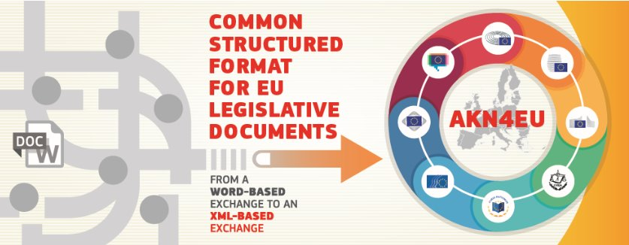
AKN4EU: Shaping the Future​ of Legal Information Exchange
AKN4EU as interoperable format

Slide 3

Interoperability: ability of two systems to communicate and work together
AKN4EU as interoperable format

Slide 4
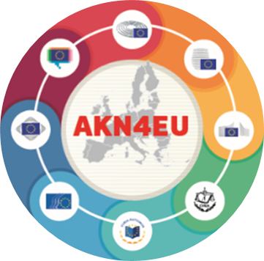
How does it work?
Collaborative standard
Development based on business needs of EU institutions​
Application of Akoma Ntoso standard in EU context​
Framed by the Interinstitutional Metadata and Formats Committee​
Initial focus on​
  Ordinary Legislative Procedure​
  Other legislative acts of the EU​
Interest from Member States
AKN4EU as interoperable format

Slide 5


Role of the publications office
The Publications Office is an interinstitutional service provider ​and acts as a trustworthy broker:​
  framework​
  technical guidance​
  knowledge sharing​
  observer in OASIS LegalDocumentML TC​
  funded by the Digital Europe Programme​
  collaboration with Interoperable Europe​
  towards a community of practice
AKN4EU as interoperable format

Slide 6
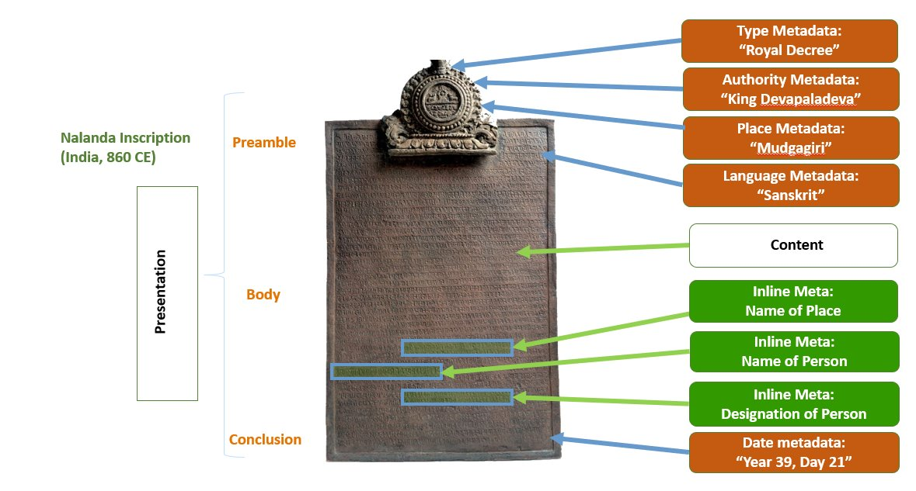
Content, metadata & presentation
AKN4EU as interoperable format

Slide 7
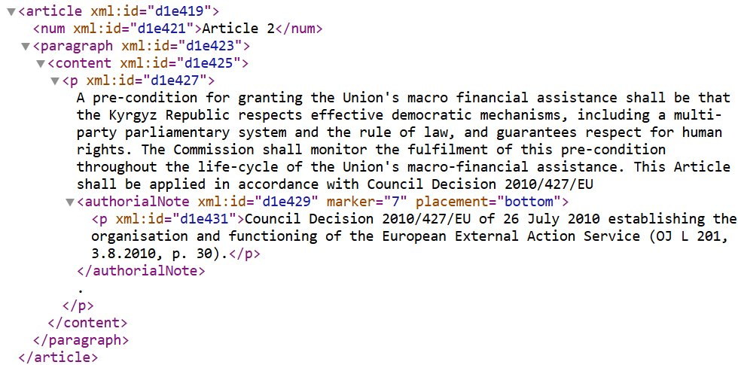
AKN4EU EXAMPLE
AKN4EU as interoperable format

Slide 8

AKN4EU ECOSYSTEM
Solutions and services for structured EU legal documents​
  Dataflow interaction across EU institutions​
  Conversion, validation and dissemination ​
  Editing solutions (LEOS)
AKN4EU as interoperable format

Slide 9
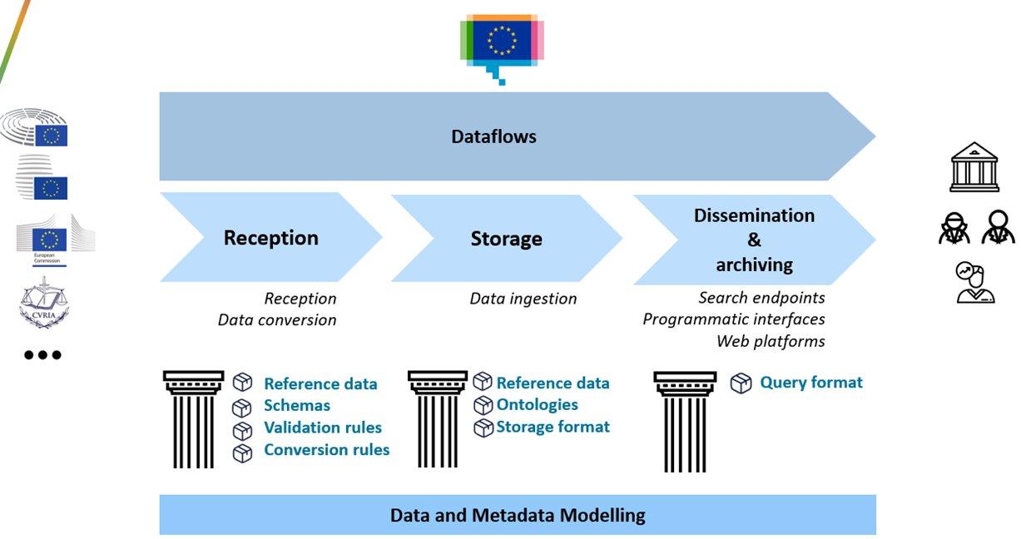
TECHNICAL IMPACT FOR THE PUBLICATION PROCESS
Publication Dataflow adaptations​
  Editing solution​
  Format Conversion​
  Format validation​
​Dissemination formats
AKN4EU as interoperable format

Slide 10
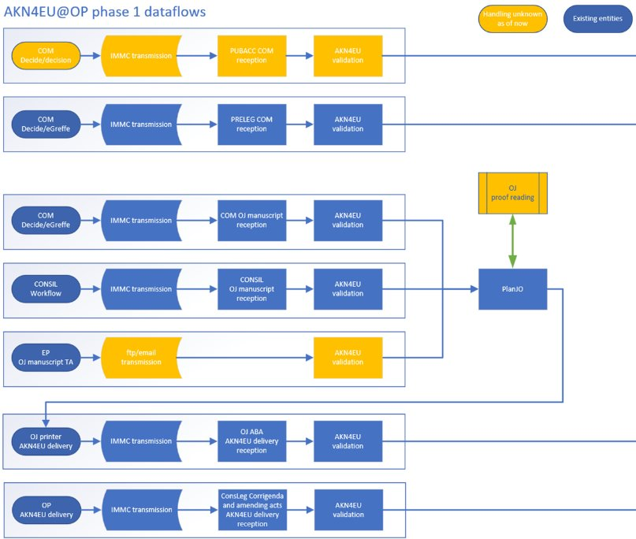
PUBLICATION DATAFLOW
ADAPTATIONS
Pre-legislation​
Official Journal Manuscript​
Official Journal Act-by-Act​
Legislation Consolidation​
…
AKN4EU as interoperable format

Slide 11
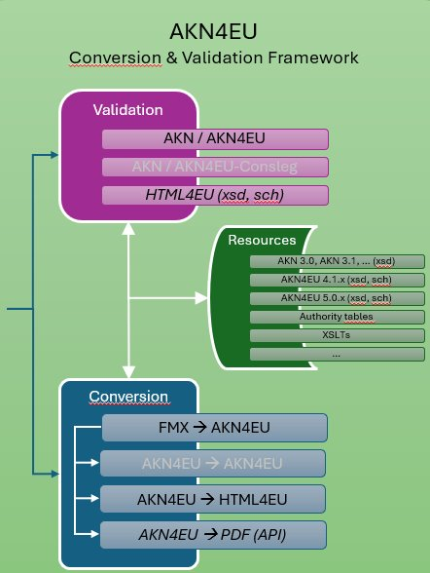
PUBLICATION DATAFLOW
ADAPTATIONS
Editing solution​
Format conversion​
Format validation
AKN4EU as interoperable format

Slide 12
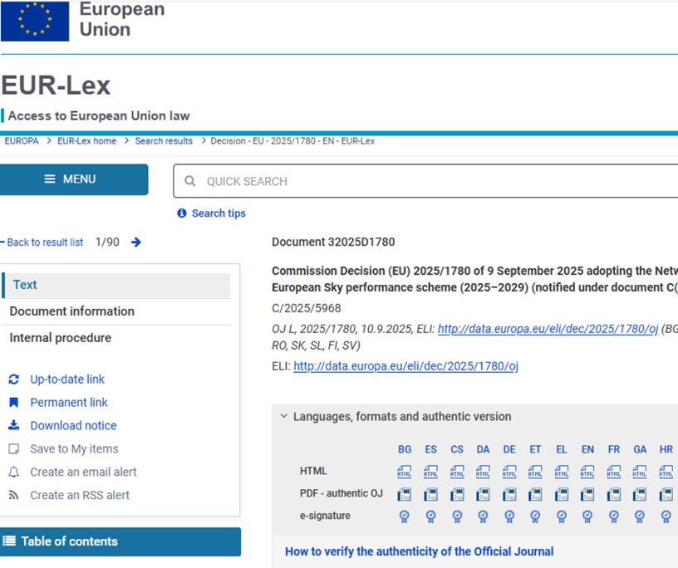
DISSEMINATION FORMATS
EUR-Lex as dissemination example where conversion is required​
  AKN4EU (XML)​
  HTML​
  PDF
AKN4EU as interoperable format

Slide 13

ADDED VALUE
Structured and machine-readable legal data​
Interoperability, traceability, efficiency ​
Collaborative work​
Cost-savings (automation,​
remove conversions)
AKN4EU as interoperable format

Slide 14
EXPLORE MORE!
AKN4EU standard​
  https://op.europa.eu/en/web/eu-vocabularies/akn4eu​
Oasis LegalDocumentML TC​
  OASIS LegalDocumentML (LegalDocML) TC | OASIS​
LEOS AKN4EU editor​
  LEOS | Interoperable Europe Portal​
Digital Europe Programme​
  https://digital-strategy.ec.europa.eu/en/activities/digital-programme​
Interoperable Europe Portal​
  https://interoperable-europe.ec.europa.eu/​
Publications Office of the European Union​
  https://op.europa.eu/en/​
EUR-Lex​
  https://eur-lex.europa.eu/
AKN4EU as interoperable format

Slide 15
Thanks!
OP-AKN4EU@publications.europa.eu

